Slide 1
E-portfolios/ LinkedIn/ Job Interviews

Slide 2
E-portfolios
a digitized collection of artifacts related to the owner's professional and academic accomplishments, including demonstrations, resources, and awards.
a powerful tool for business students to gain self-awareness and take control of their learning experiences.
It’s a compilation of experiential learning evidences.
They allow students to reflect on their performance, receive feedback, and prepare their best work to show to future employers or clients.
can be used as online profiles in the job application process, allowing more authenticity, personalization, and completeness than traditional résumés

Slide 3
What to include in E-portfolio
An ePortfolio may contain all or some of the following:
Files of various formats (text, pictures, video, etc.)
Evidence related to courses taken, programs of study, etc.
Writing samples (which might include several drafts to show development and improvement)
Projects prepared for class or extracurricular activities
Evidence of creativity and performance
Evidence of extracurricular or co-curricular activities, including examples of leadership
Evaluations, analysis and recommendations

Slide 4
How are e-portfolios beneficial for your career?
an avenue to show potential employers your abilities.
demonstrates soft skills that you can’t mention in your resume.
to enhance the reach and utility of digital badges

Slide 5
Issues to consider
Setting standards: avoid gaps & inconsistencies
Timing: earlier an individual begins building their portfolios, the more they’ll benefit from the records of long-term learning.
Cost: Make sure you have a clear understanding of these costs before you pick a platform for your long-term needs.
Technology: training for students, faculty members, or employees to understand how to use e-portfolios to their full potential

Slide 6
How to choose an effective e-portfolio platform
Ease of use: easy to access and intuitive to use.
Shareability: opportunity to connect with others for feedback and interaction to build their professional networks.
Permanence: users should be able to build a lifelong profile.
Extra features: digital credentialing and learning pathways

Slide 7
LinkedIn Profile
well-recognized and widely used site that focuses on networking with professionals.
A platform to connect, share, and present oneself through an online portfolio.

Slide 8
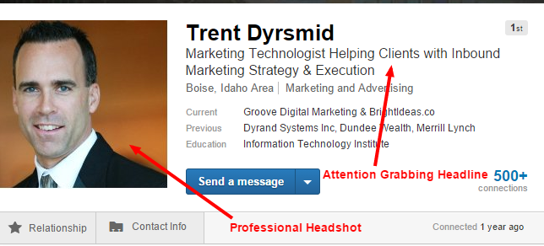
Think of your LinkedIn profile as a rich (and graphical ) view of who you are and what you do. If you thoughtfully structure your career story, hiring managers will likely check out the details.

Slide 9
How to set up your LinkedIn profile
There are a few core components to your profile that you can’t ignore.
Your Headshot. This should be a professional image that expresses you in the business world.
Your Headline. Your headline appears in search results and is the first thing that people see. It should include keywords to help you get found and attention grabbing verbiage to help you stand out. It’s a delicate balance but with some thought and creativity, you can make it happen.
Your Specialties. What makes you unique? What makes you stand out from other professionals in your niche? This is your time to shine so don’t be afraid to brag a little. And when you do, make sure to include a few more keywords so that LinkedIn’s search engine knows how to present you.

Slide 10
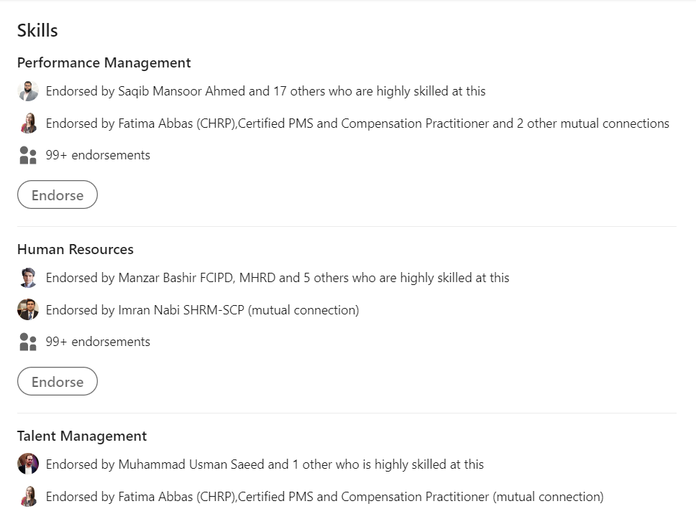

Slide 11
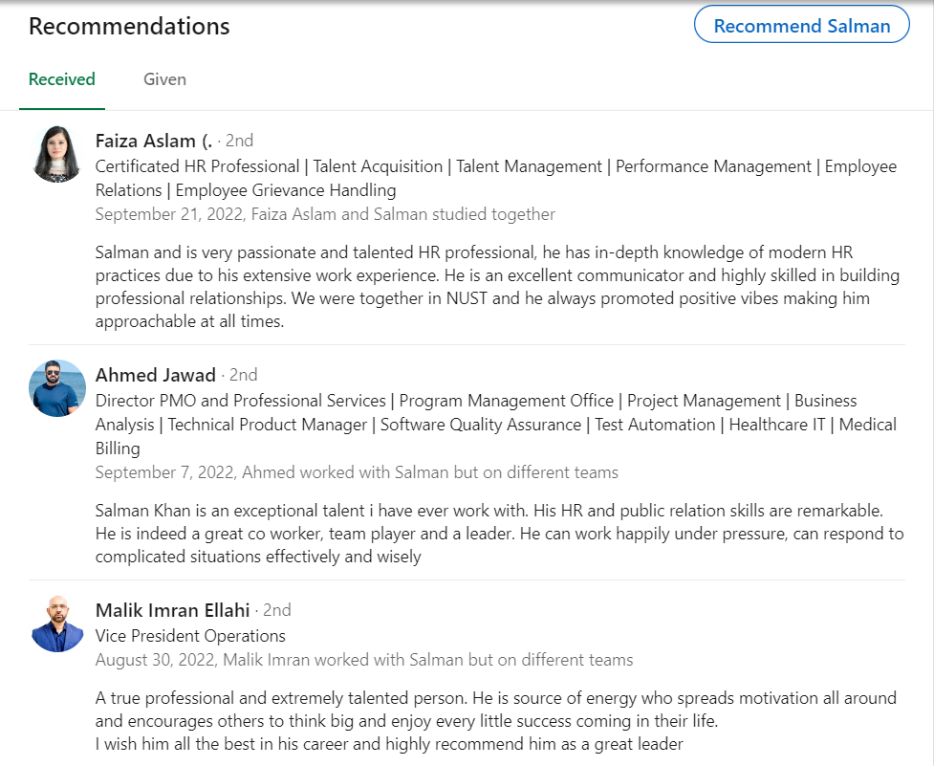

Slide 12
Techniques for effective Job Interviews
Dress professionally
Be on time
Watch your body language
Don’t chew gum, smoke or drink beverages during the interview
Turn off your cell phone
Watch how you say and what you say
Bring supporting documents to the interview
Research the company
Be familiar with typical interview questions
When answering questions, focus on company’s specific needs

Slide 13
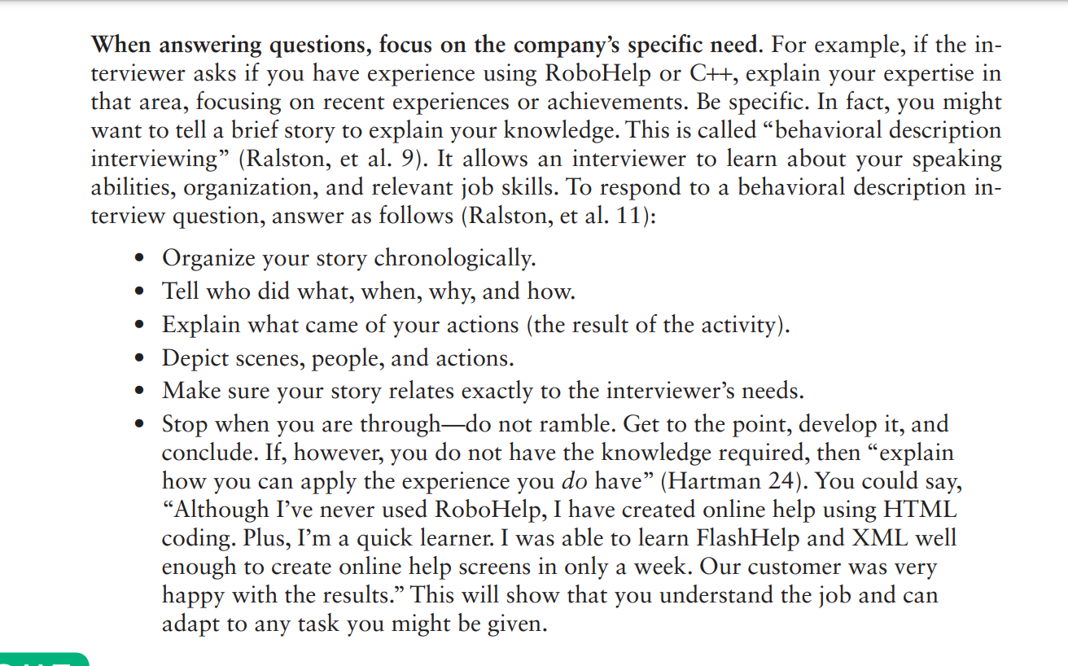

Slide 14
Criteria for Effective Follow-up Interview
A follow-up letter or e-mail message contains an introduction, discussion, and conclusion.
Introduction. Tell the readers how much you appreciated meeting them. Be sure to state the date on which you met and the job for which you applied.
Discussion. In this paragraph, emphasize or add important information concerning your suitability for the job. Add details that you forgot to mention during the interview, clarify details that you covered insufficiently, and highlight your skills that match the job requirements. In any case, sell yourself one last time.
Conclusion. Thank the readers for their consideration, or remind them how they can get in touch with you for further information. Don’t, however, give them any deadlines for making a decision.

Slide 15
